Slide 1

EPPS 6356-Data Visualization Project proposal-Wage Trends by Sectors among Different Countries
Instructor: Karl Ho
Present by Yuming Wang

Slide 2
Background
“Wages earnings are an important income for people to make a living and support families and employees are expected to have wage increase to raise their living standards” (Congressional Research Service).

Slide 3
Research Statement
I am interested in studying how the workers’ wages grow differently in various sectors in last decade in different countries. Did their growth rates appear similarly or have significant differences among different countries? Specifically, I would like to compare the differences of wages growth rate by sectors in US, Canada, and China.

Slide 4
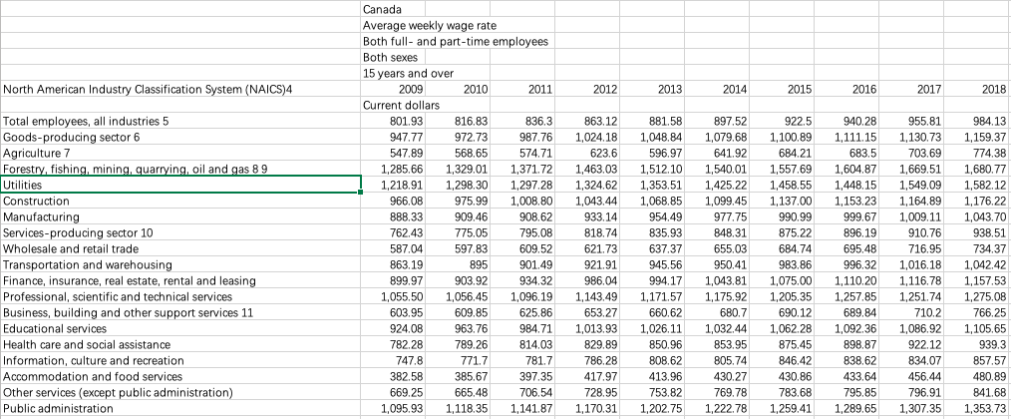
Data
Canada average wage by each sector

Slide 5
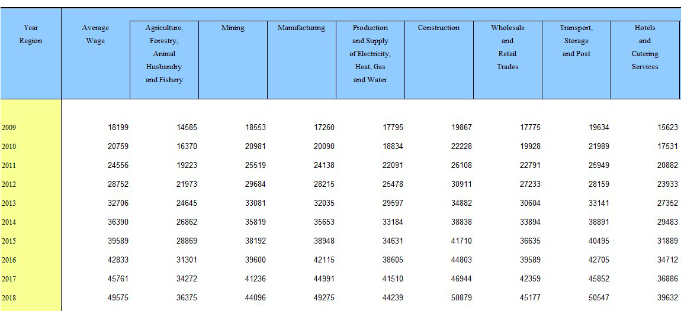
Data
China average wage by each sector

Slide 6
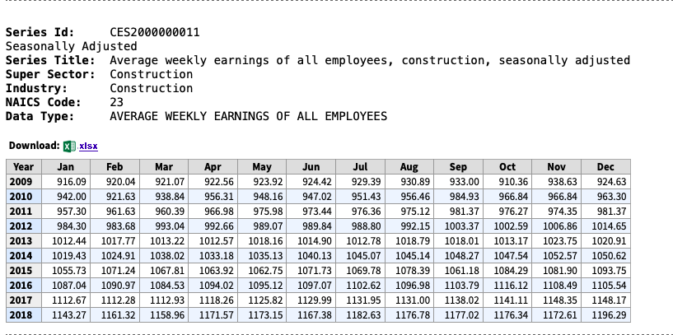
Data
U.S. average wage by each sector

Slide 7
Visualization Method
Platform:
Use R
ggplot2
Chart:
Bar Chart

Slide 8
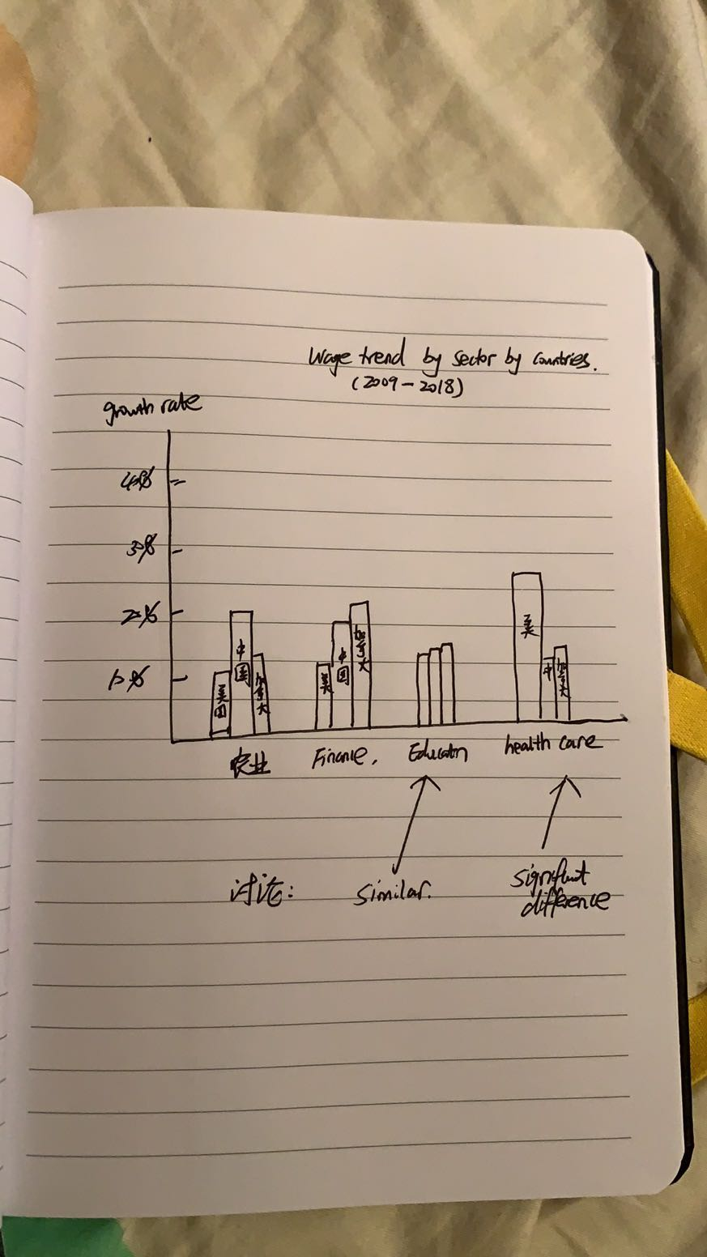
Layout

Slide 9
Reference
Congressional Research Service. July 23, 2019. Real Wage Trends, 1979 to 2018. Retrieved from
https://fas.org/sgp/crs/misc/R45090.pdf#:~:text=Other%20factors%20are%20likely%20to%20contribute%20to%20wage,institutions%2C%20workplace%20organization%20and%20practices%2C%20and%20macroeconomic%20trends.
National Bureau of Statistics of China. Retrieved from http://www.stats.gov.cn/tjsj/ndsj/2019/indexeh.htm
Statistic Canada. Retrieved from
https://www150.statcan.gc.ca/t1/tbl1/en/tv.action?pid=1410006401&pickMembers%5B0%5D=1.1&pickMembers%5B1%5D=2.3&pickMembers%5B2%5D=3.1&pickMembers%5B3%5D=5.1&pickMembers%5B4%5D=6.1&cubeTimeFrame.startYear=2005&cubeTimeFrame.endYear=2019&referencePeriods=20050101%2C20190101
U.S. Bureau of Labor Statistics. Retrieved from https://www.bls.gov/webapps/legacy/cesbtab3.htm

Slide 10
Thank you for your time!!!

